Slide 1




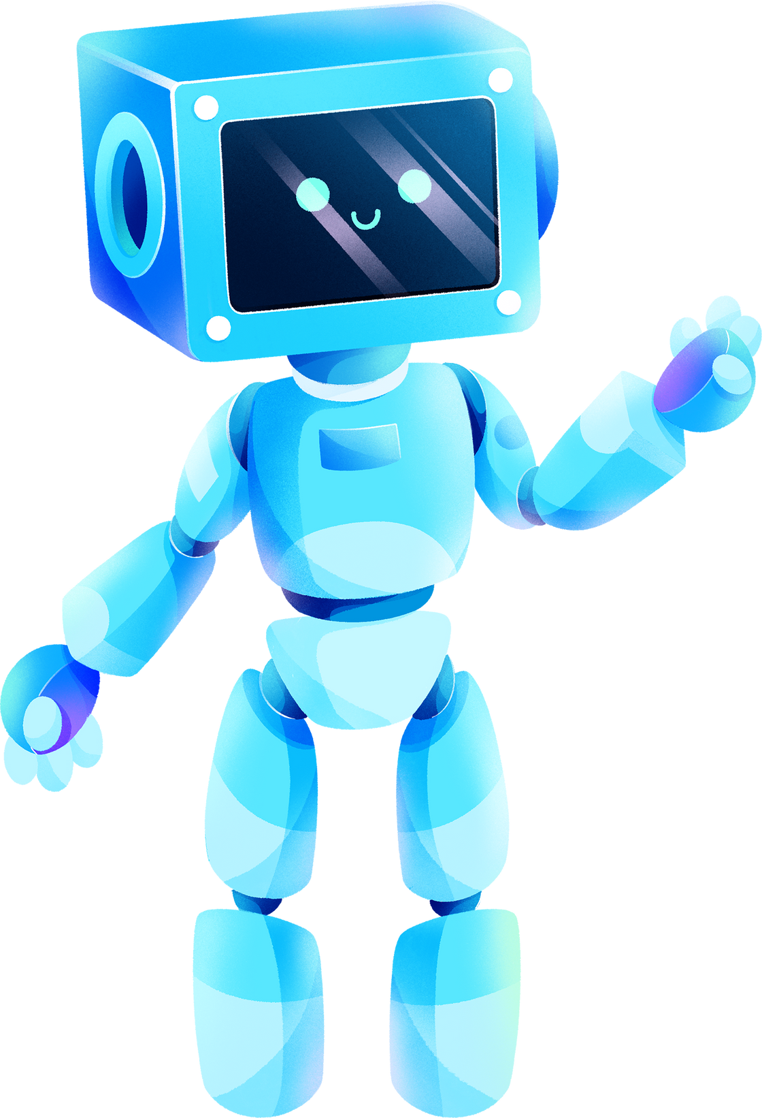

ARTIFICIAL INTELLIGENCE
NATURAL LANGUAGE PROCESSING
PROJECT

Slide 2





Audio Book
TALKING
BOOK
Presented by:
R K JAYASURYA
K RAGAVAN
P SIVAKKUMARAN
AURCC

Slide 3

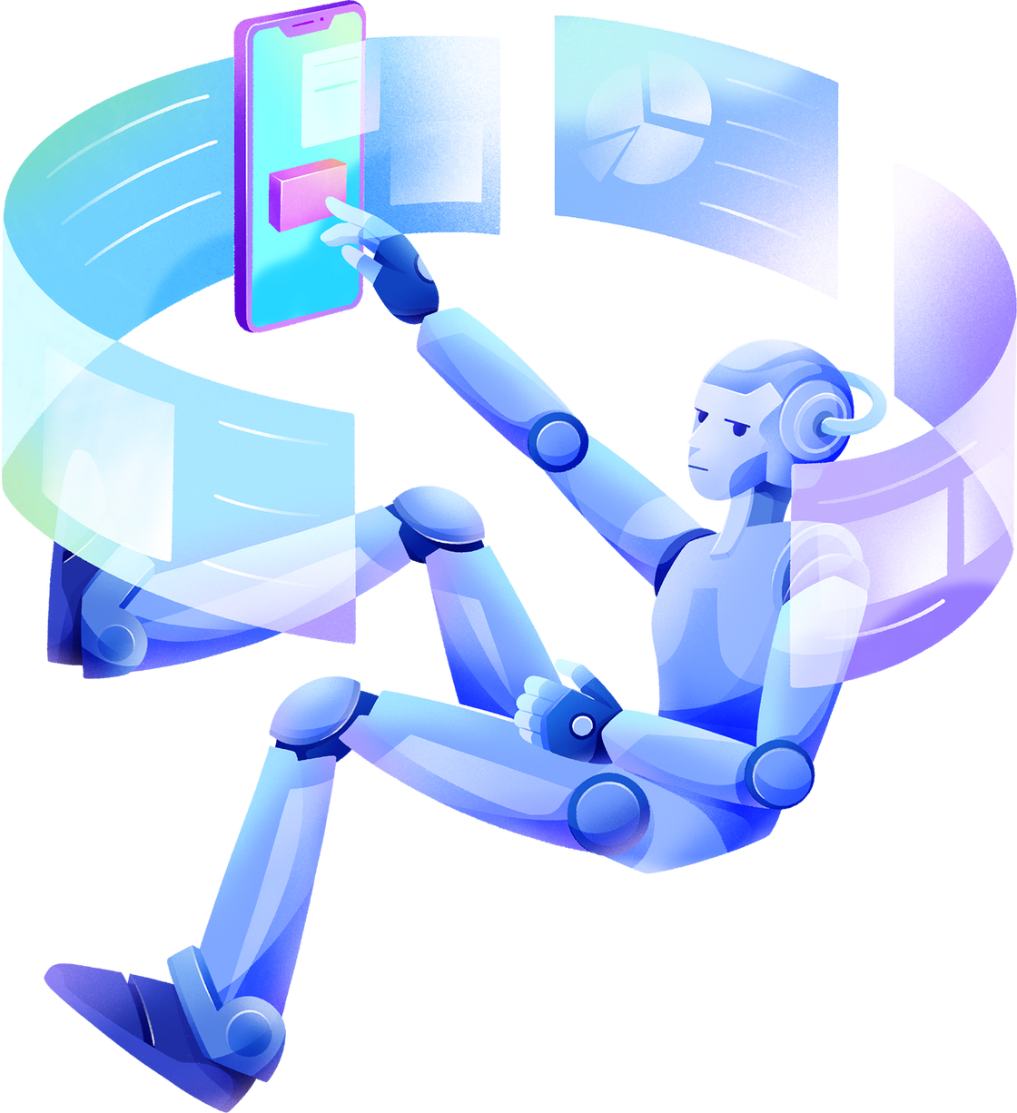

AGENDA
PROJECT DESCRIPTION
MARKET NEED
TECHNOLOGIES USED
FUTURE PLANS
CONCLUSION

Slide 4

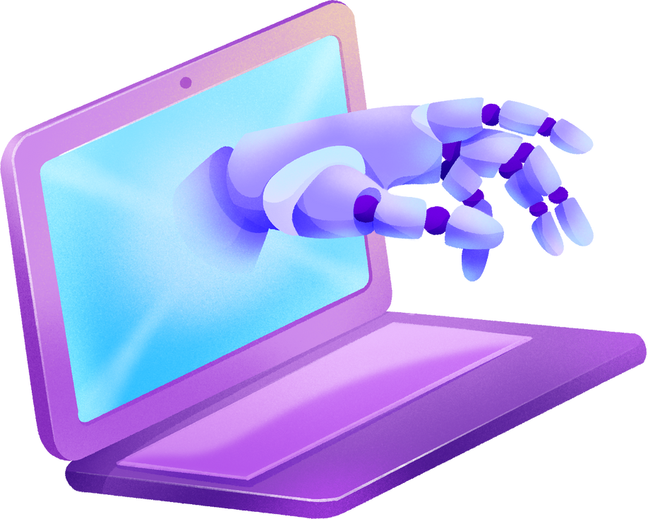
PROJECT DISCRIPTION
THIS PROJECT IS ABOUT CONVERTING THE PDF FILE TO HEARABLE AUDIO FILE(.MP3 EXTENSION). BY USING THIS APPLICATION WE CAN EASILY INTAKE THE CONTENT OF A PDF FILE IN A HEARING FORMATE INSTEAD OF READING.

Slide 5

MARKET NEED
Audiobooks have traditionally been used with second-language learners, learning-disabled students, and struggling readers or nonreaders.
In many cases, audiobooks have proven successful in helping these students to access literature and enjoy books.
The involvement of well-known actors, authors, or personalities as narrators, combined with high production quality, has elevated the appeal of audiobooks, making them an attractive option for a wider audience.

Slide 6
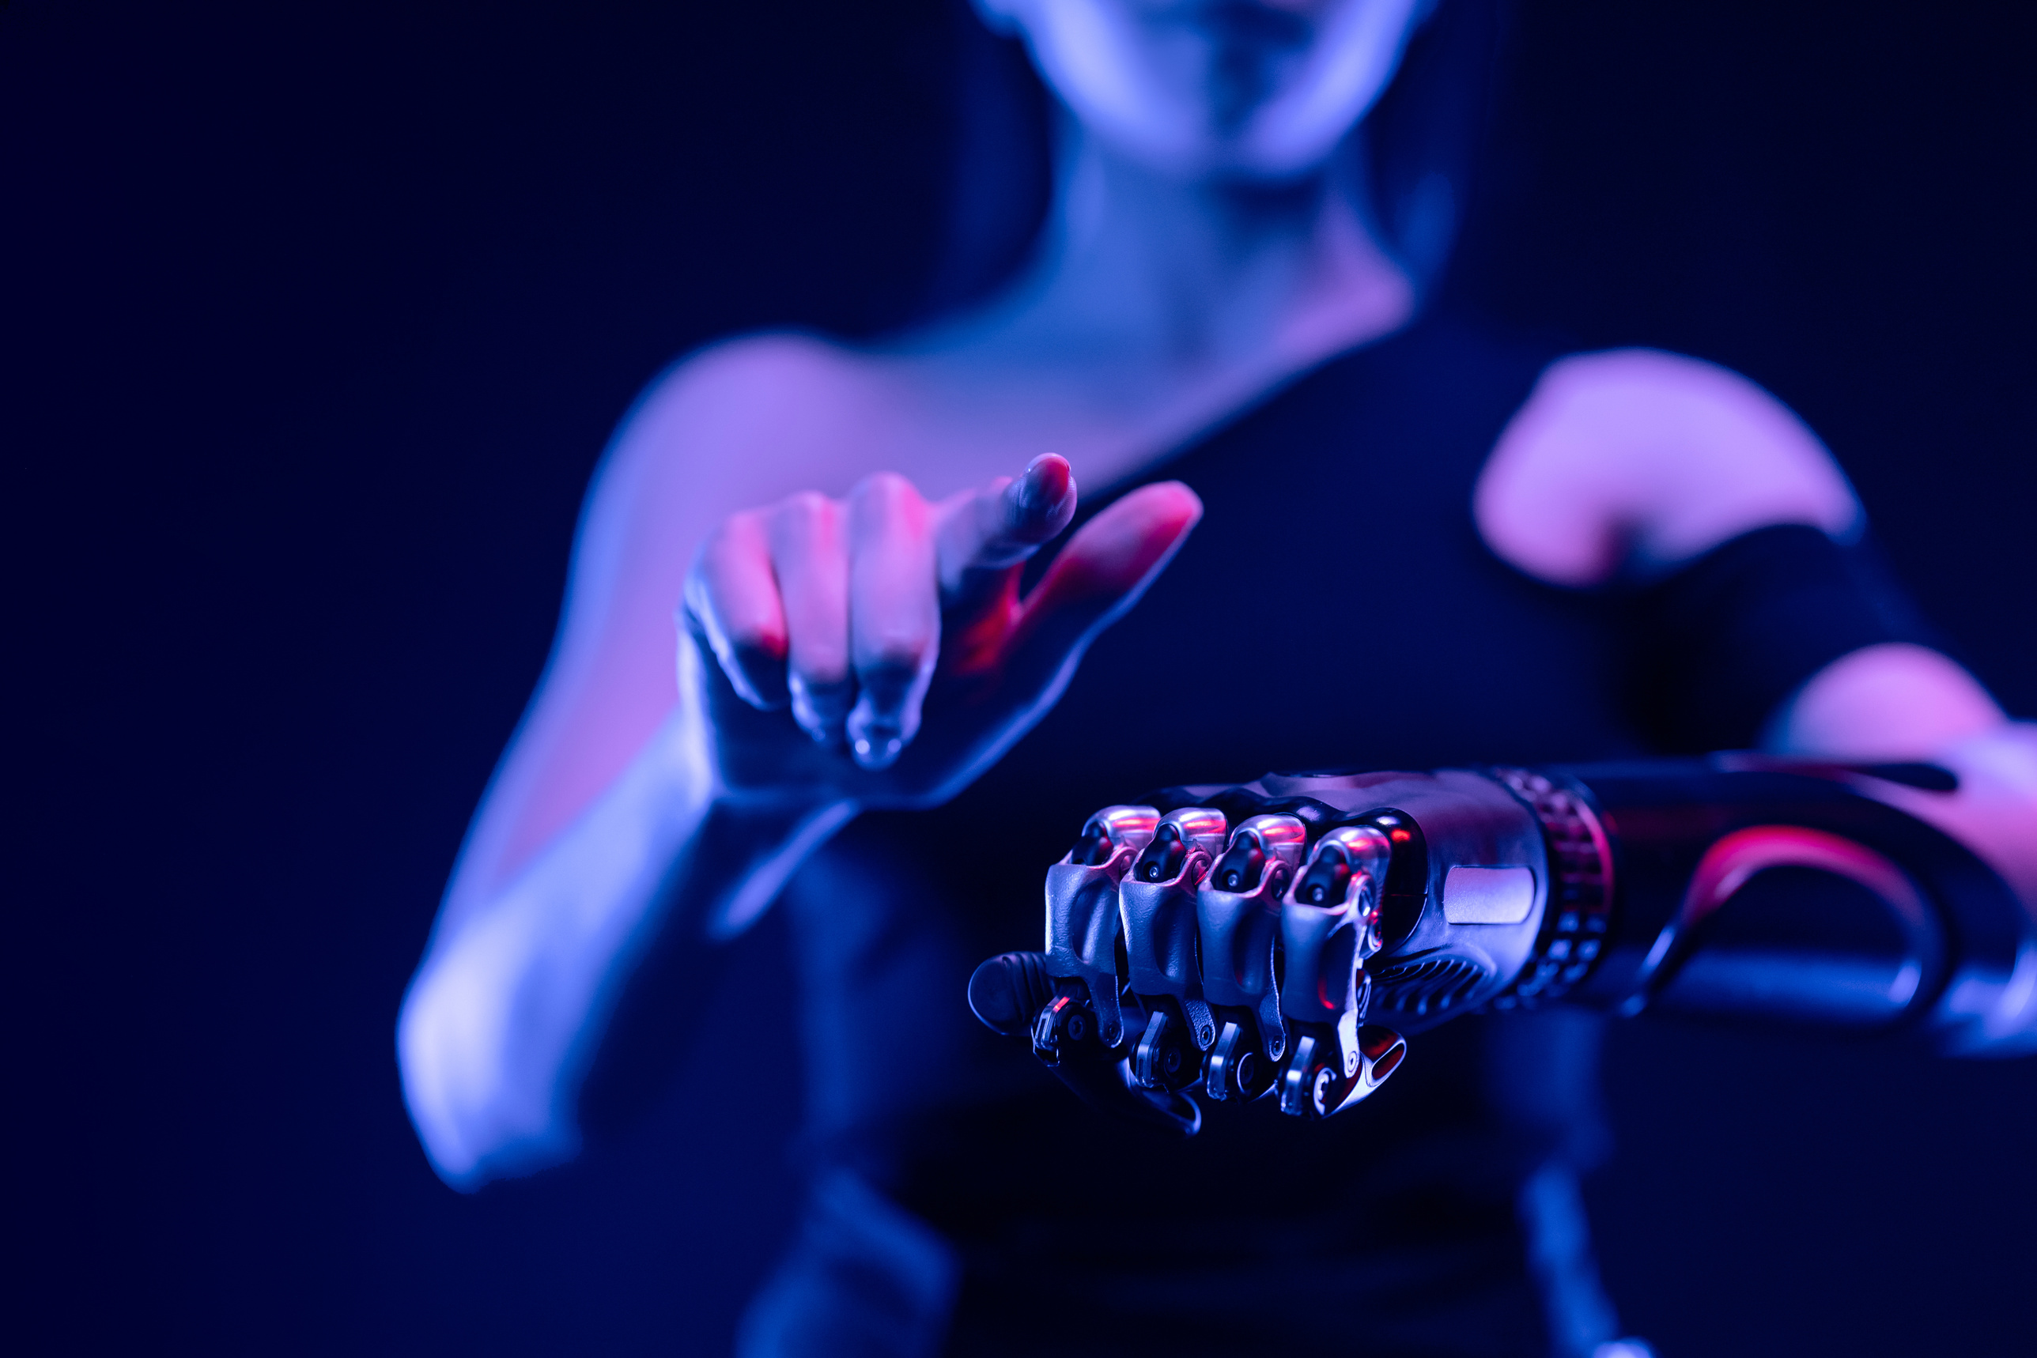

TECHNOLOGIES USED
01
02
03
04
Speech Recognition
PyMuPDF
pyttsx3
Audio Player

Slide 7






FUTURE PLAN
LANGUAGE
FILE FORMAT
VOICE
Providing users with conversion of languages of the audiobook
Getting and giving textual file and audio file in various formats
Voice conversion like providing audio file in celebrity voices

Slide 8


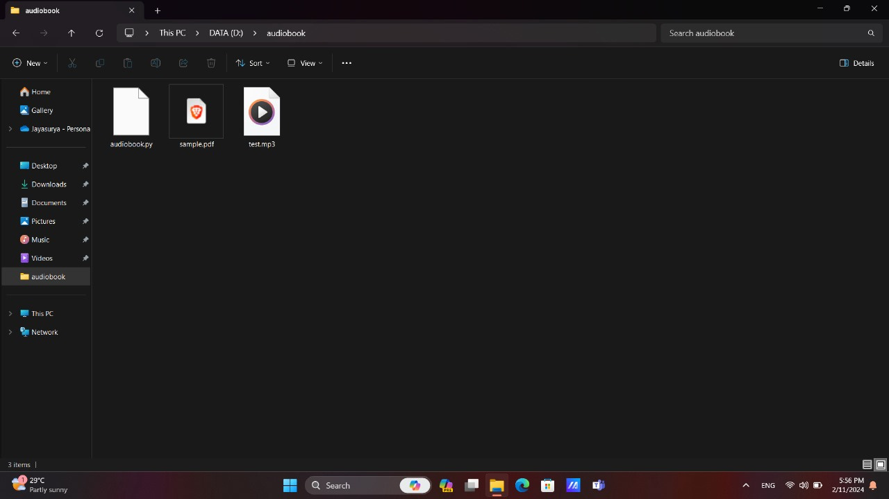


RESULTS AND ACHIEVEMENTS

Slide 9
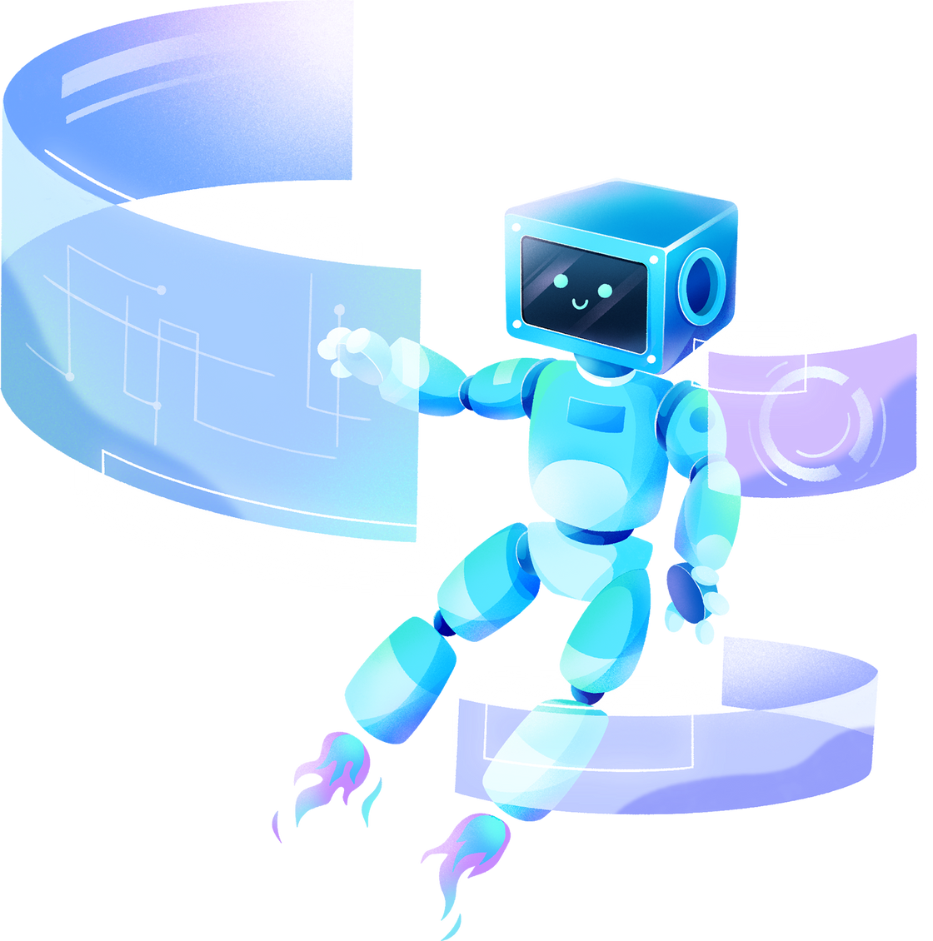
THANK YOU!

